Slide 1
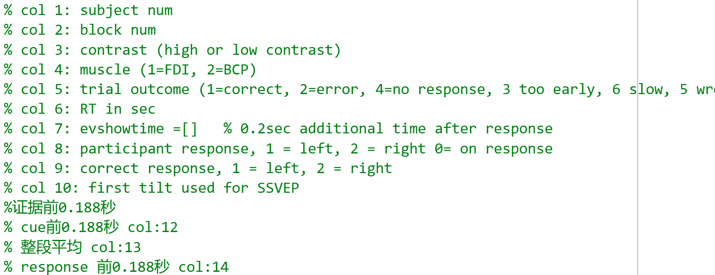
All analysis Exclude invalided trials when too early and wrong muscle CPP channel: 19

Slide 2

SL pre-cue -188ms (CW / HL) SL pre-evidence -188ms (FB)
Correct vs wrong
FDI vs BCP
High vs Low

Slide 3
Correct Vs wrong(SL_b)
Drift rate different since ‘evidence on’
After response amplitude drops faster
Lowest at response time
(from scalp plots) correct have clearer CPP burst around 300-900 than wrong
(from scalp plots) same amplitude; but correct CPP moves more to centre from 300-900
Notes:
EEG_sorting_plot_SL_b.m

Slide 4
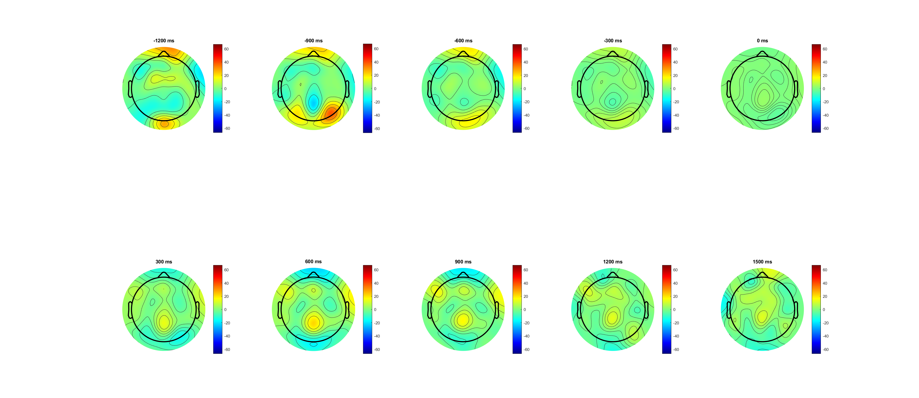
Correct (-1200:1500) pre evd

Slide 5
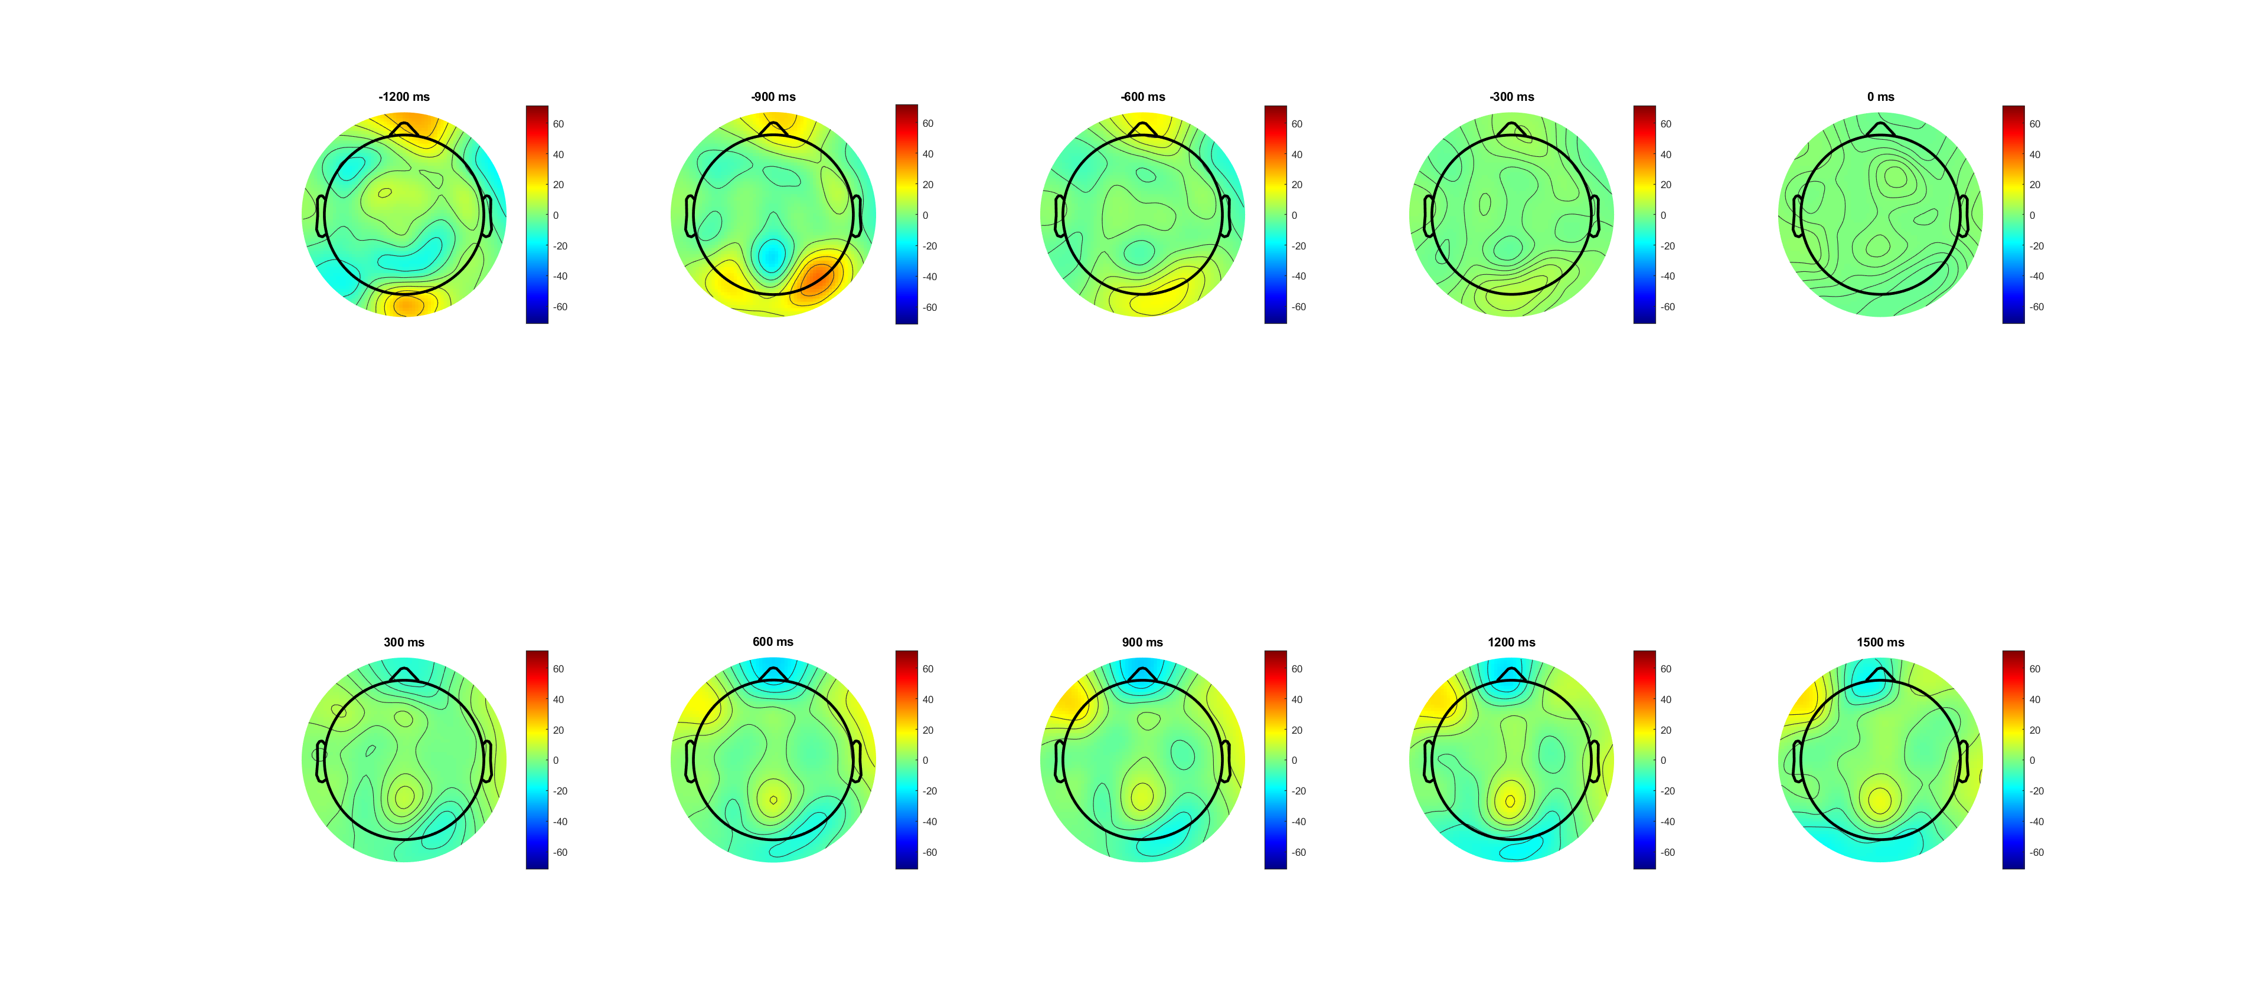
Wrong (-1200:1500) pre evd

Slide 6
Correct Vs wrong(SL pre-cue -188ms) amplitude larger
Drift rate different since ‘evidence on’
After min evidence amplitude drops faster
Lowest at response time
(from scalp plots) correct have clearer CPP burst around 300-900 than wrong
(from scalp plots) same amplitude; but correct CPP moves more to centre from 300-900
* trial number 4:1
C1 (at baseline on)
SSVEP (after baseline on)
Emergency (300ms after cue change)
Drift rate diff (after EVon);
Peak around 500
Drop after decision/ action; maintain if wrong
Second peak after DDL1.5 (Emergency caused by time pressure?)
Notes:
EEG_sorting_plot_SL_bb.m

Slide 7
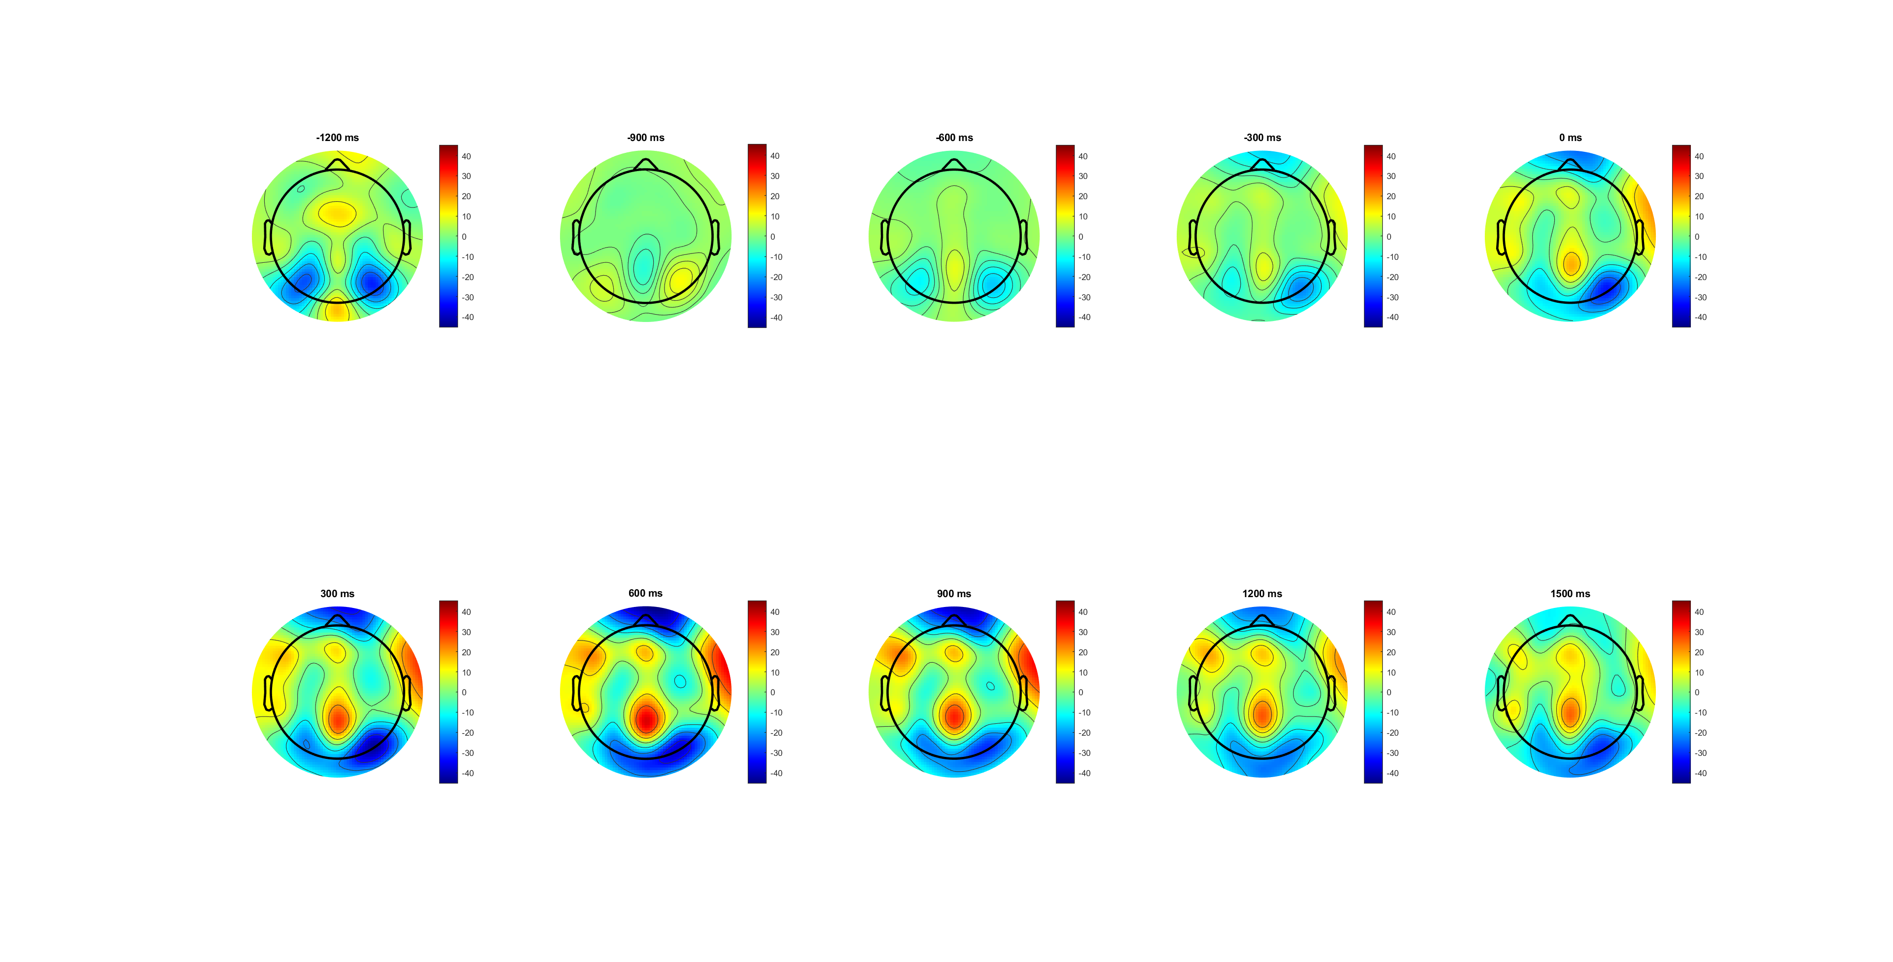
Correct (-1200:1500) pre cue
CPP seems start -600(after cue),
peak at 600
Move from partial to centra?

Slide 8
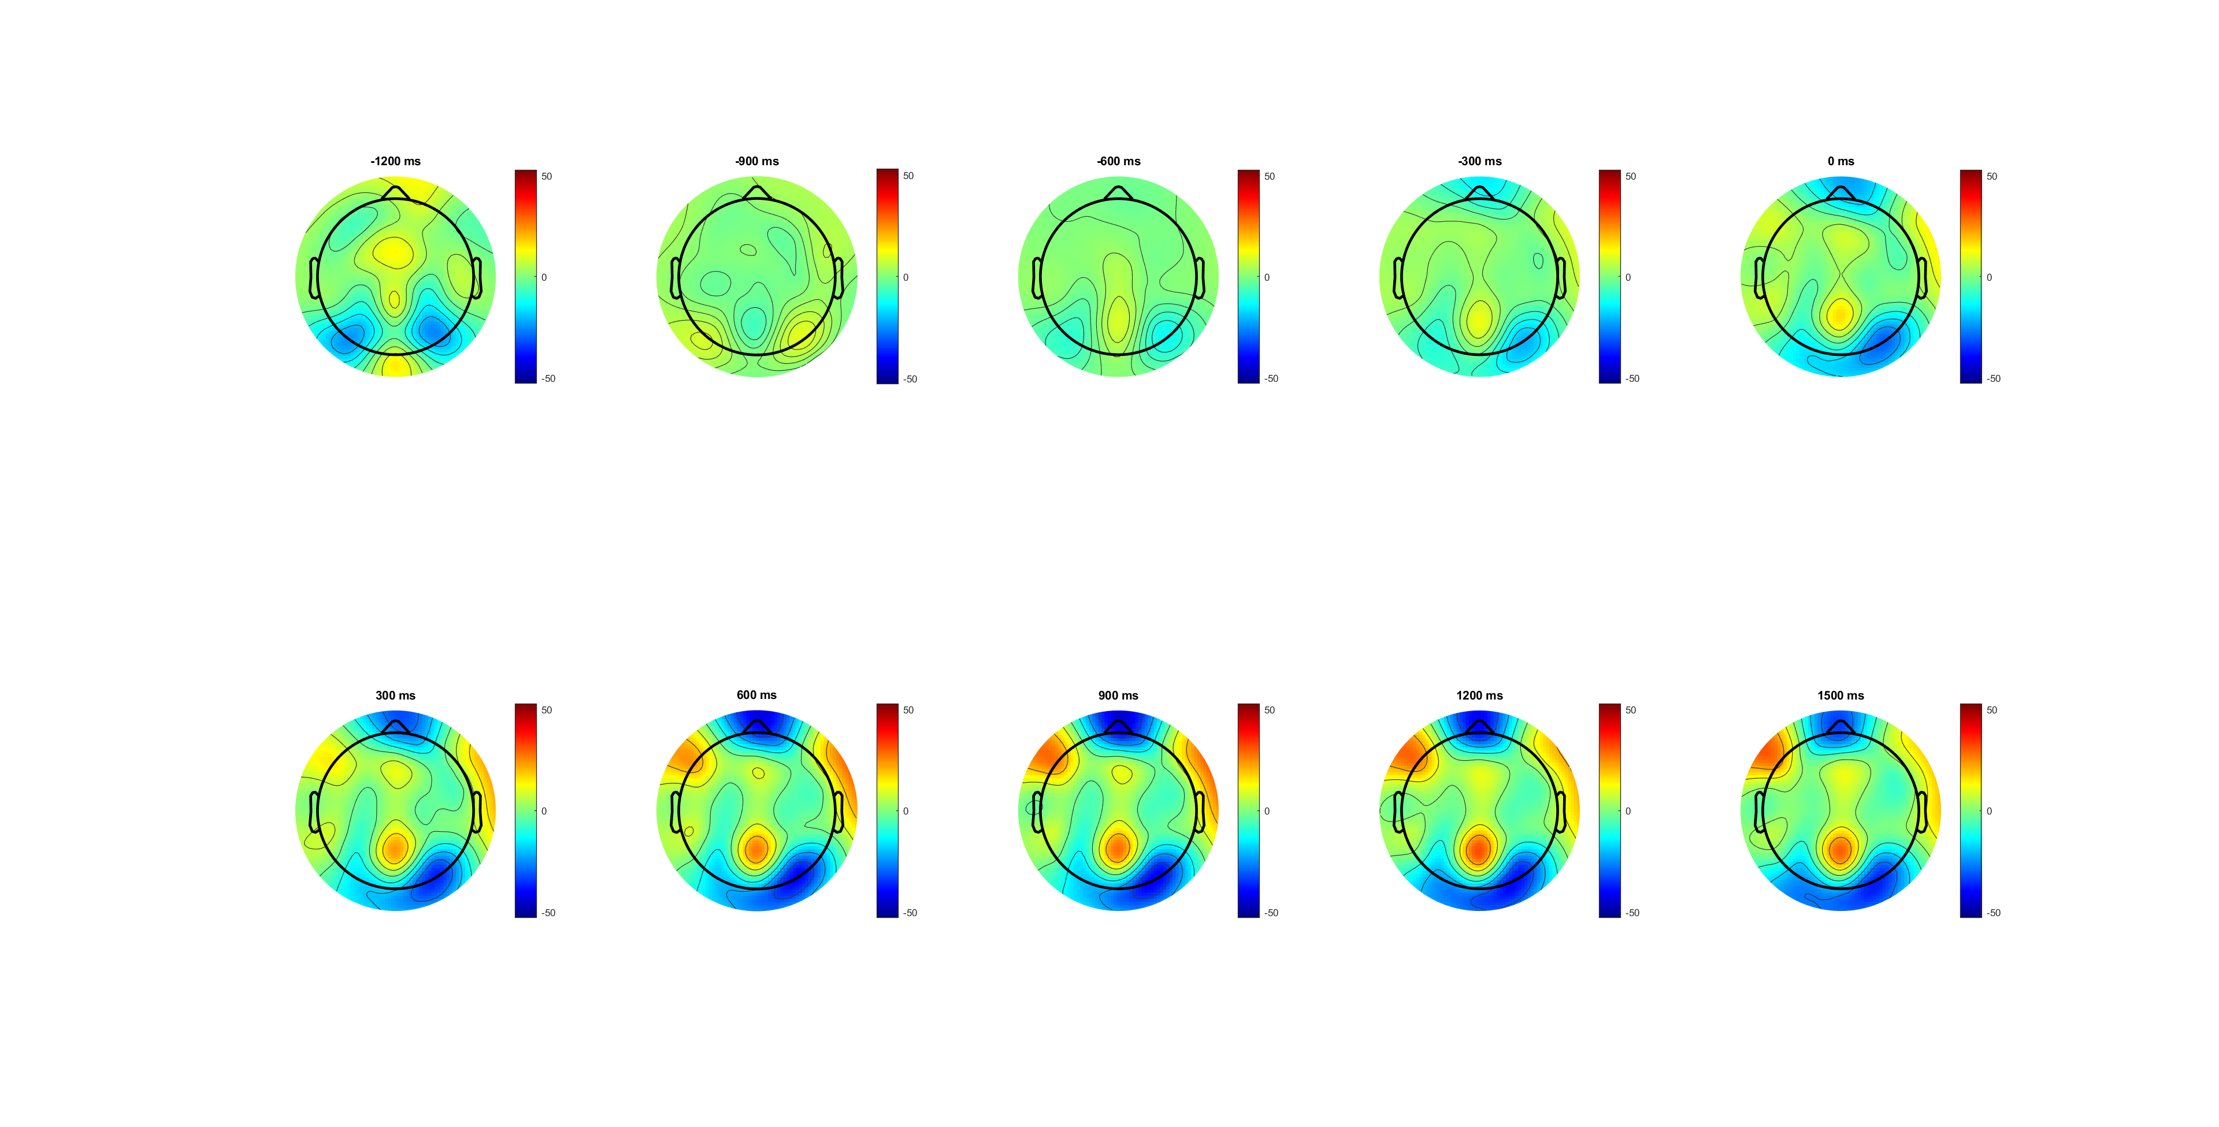
Wrong (-1200:1500) pre cue
CPP seems start -600(after cue),
Maintain for the rest
Location not moving

Slide 9
High Vs Low(SL_bb)
Low is more like wrong condition
pre-cue baseline (seems already acc before evidence)
(from scalp plots) high is more observious
Emergency/ACC (300ms after cue change)- only for high??
Drift rate diff (after EVon);
Peak around 500 ; -only high
Drop after decision/ action; maintain for low
Second peak after DDL1.5 (Emergency caused by time pressure?) -both
Notes:
EEG_sorting_plot_SL_bb.m

Slide 10
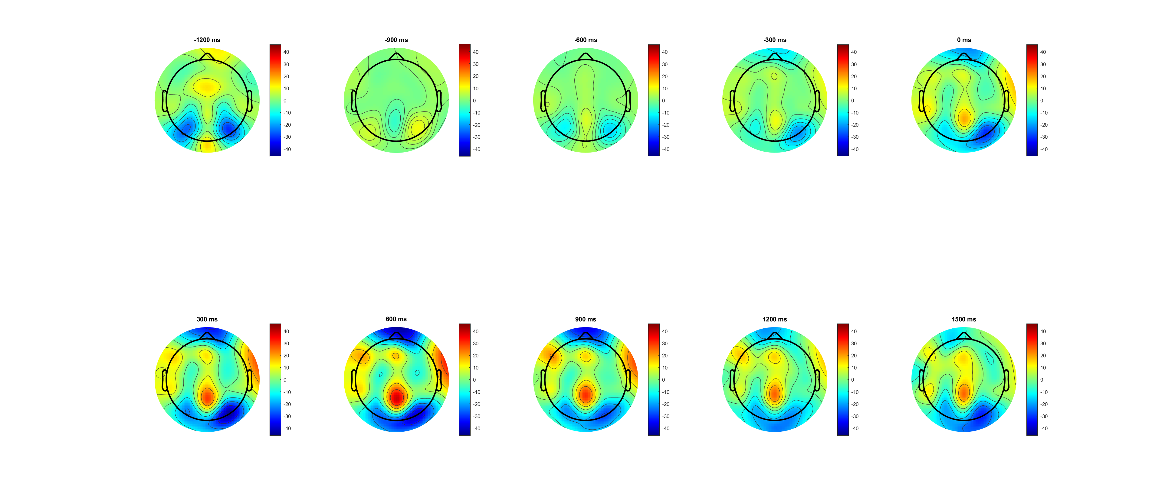
High,0.14 (-1200:1500) pre cue
Deeper CPP
Move from partial to centra

Slide 11
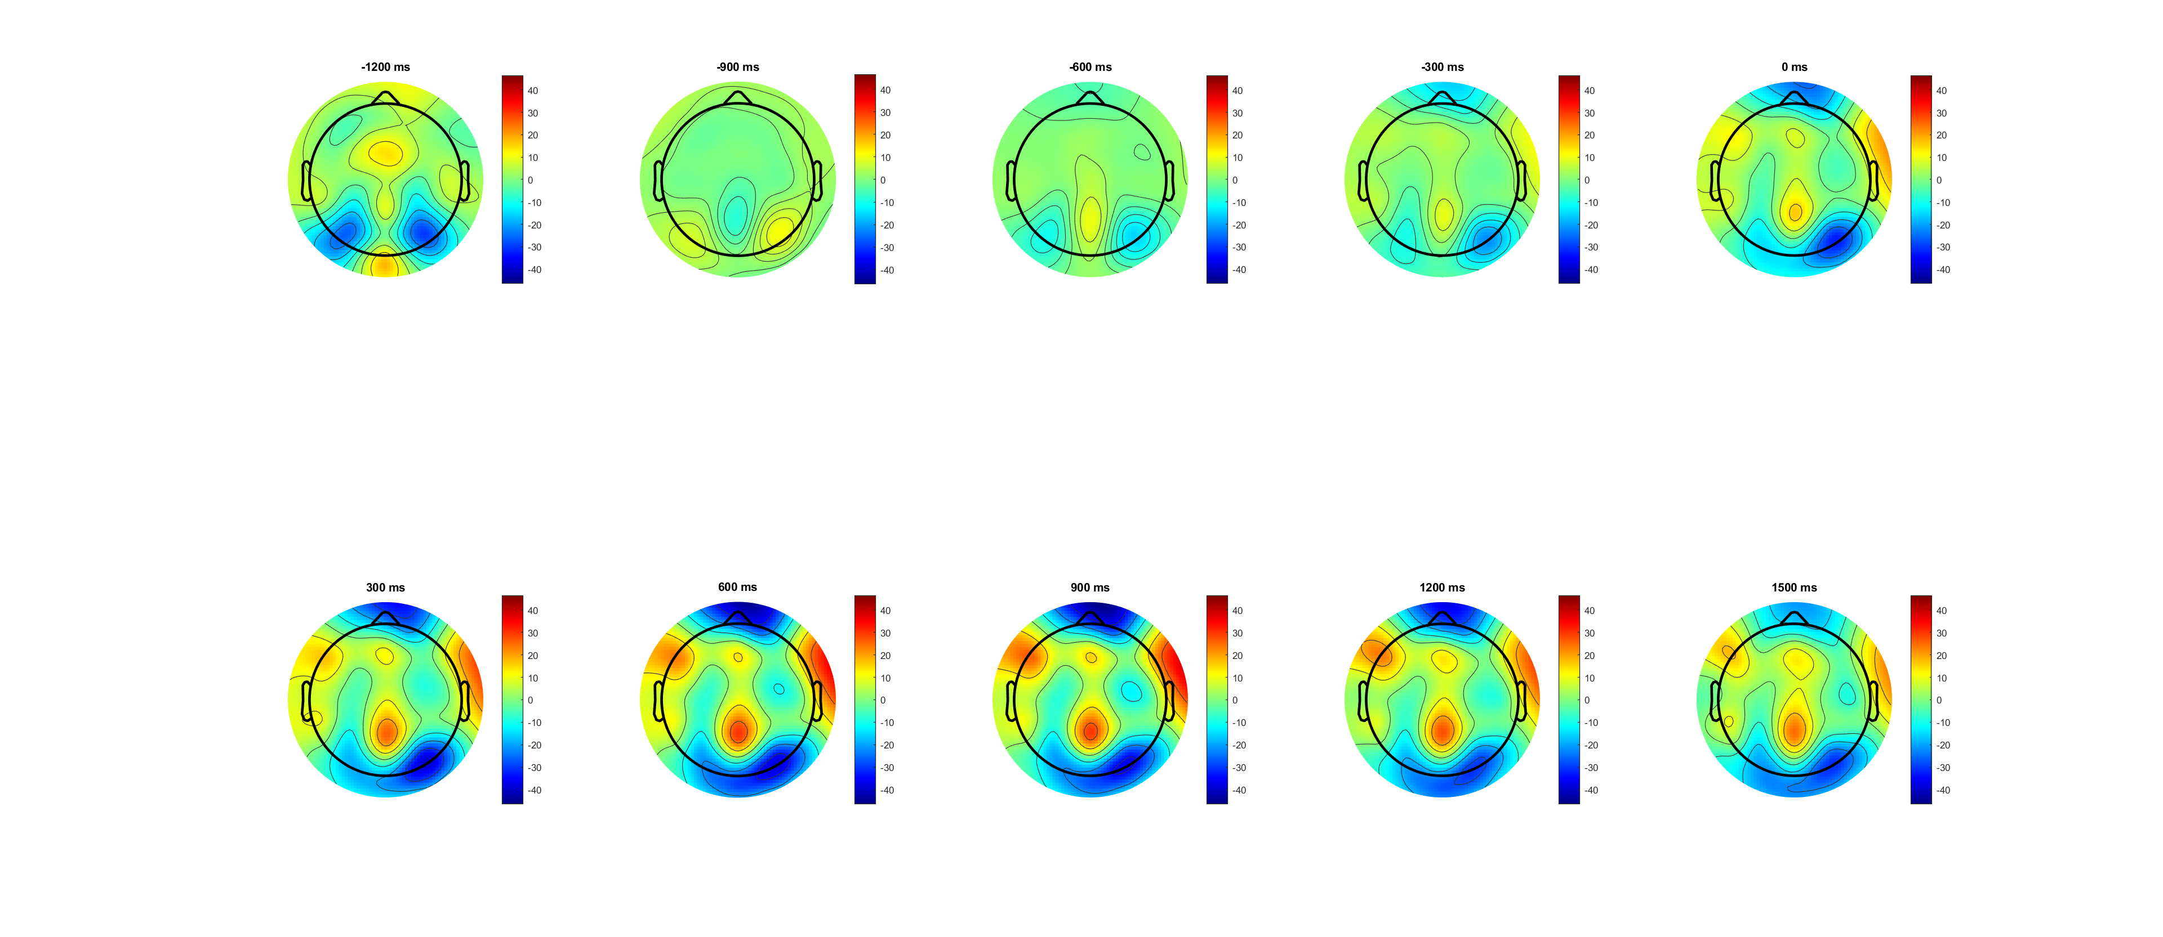
Low,0.07 (-1200:1500) pre cue
less CPP
Not moving

Slide 12
High Vs Low(SL_b)
Low is more like wrong condition
Should check in pre-cue baseline (seems already acc before evidence)
(from scalp plots) high is more observious
Notes:
EEG_sorting_plot_SL_b.m

Slide 13
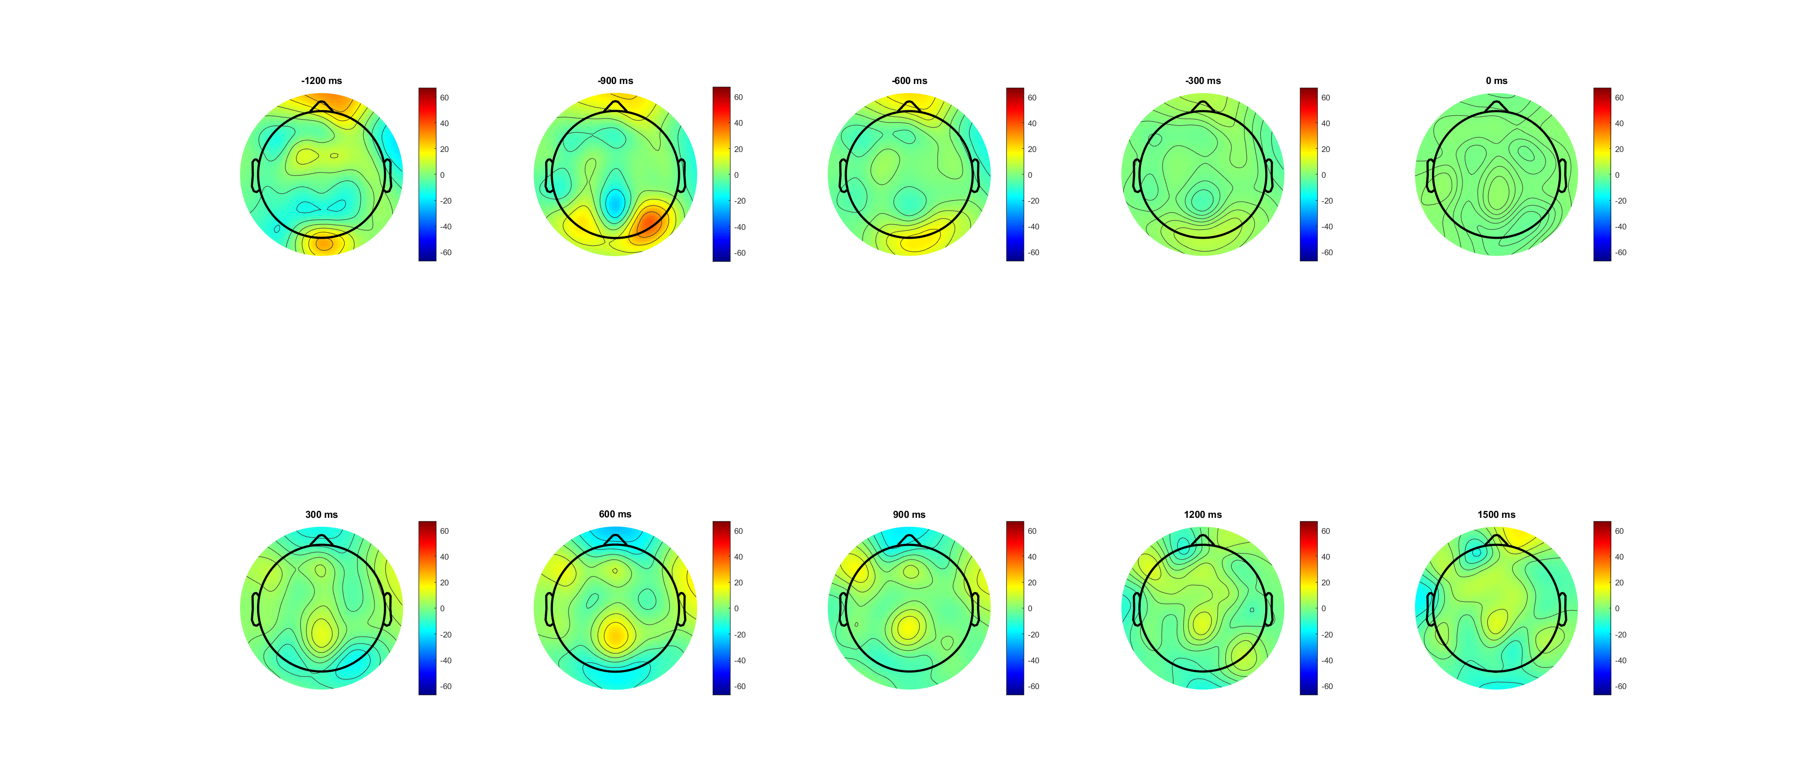
High,0.14 (-1200:1500) pre evidence

Slide 14
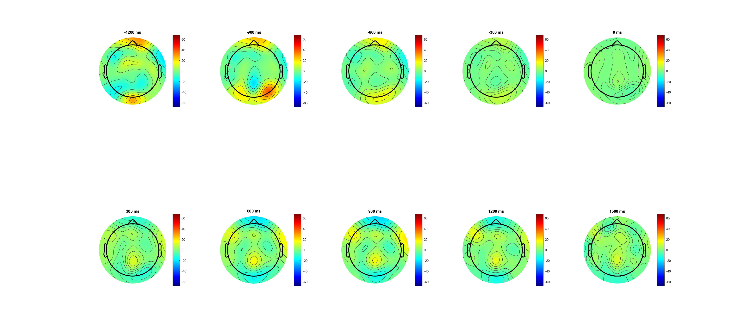
Low,0.07 (-1200:1500) pre evidence

Slide 15
FDI Vs BCP(ERP more clear in pre evidence plot)
Overall BCP lower than FDI!!! But higher between 1.5 and 2
Drift rate slightly different since ‘evidence on’
Lowest at response time
(from scalp plots) FDI slightly stronger!
Drift rate diff (after EVon);
Peak around 500 ; BCP drop slop faster
BCP slop raise after DDL 15 (emergency due to time pressure?)
Where 123 come from- look deeper
Notes:
EEG_sorting_plot_SL_b.m

Slide 16
Pre cue
Not observious
Notes:
Pre cue

Slide 17
FDI vs BCP correct(L) wrong(R)
Overall BCP lower than FDI!!!
But higher between 1.5 and 2 (mainly from wrong trials)
Notes:
Pre evidence

Slide 18
FDI vs BCP correct(L) wrong(R)
Overall BCP lower than FDI!!!
But higher between 1.5 and 2 (mainly from wrong trials)
Notes:
Pre cue

Slide 19
FDI vs BCP correct high(0.14 left) low (0.07) right
Among correct trials
The higher FDI in period (0 800) mainly comes from high contrast/ slightly from low
The higher FDI in period (800 1500) mainly come from low
Notes:
Pre evd

Slide 20
FDI vs BCP correct high(0.14 left) low (0.07) right
Among correct trials
The higher FDI in period (0 800) mainly comes from high contrast
The higher FDI in period (800 1500) mainly come from low
Notes:
Pre cue

Slide 21

FDI vs BCP wrong high(0.14 left) low (0.07 right)
Among wrong trials (192trial vs 197 trial? Still available?)
BCP always higher in ‘high’ after evidence finish (less Com?)
Notes:
Pre evd

Slide 22
FDI vs BCP wrong high(0.14 left) low (0.07 right)
Among wrong trials (192trial vs 197 trial? Still available?)
BCP always higher in ‘high’ after evidence finish (less Com?)
Notes:
Pre cue

Slide 23
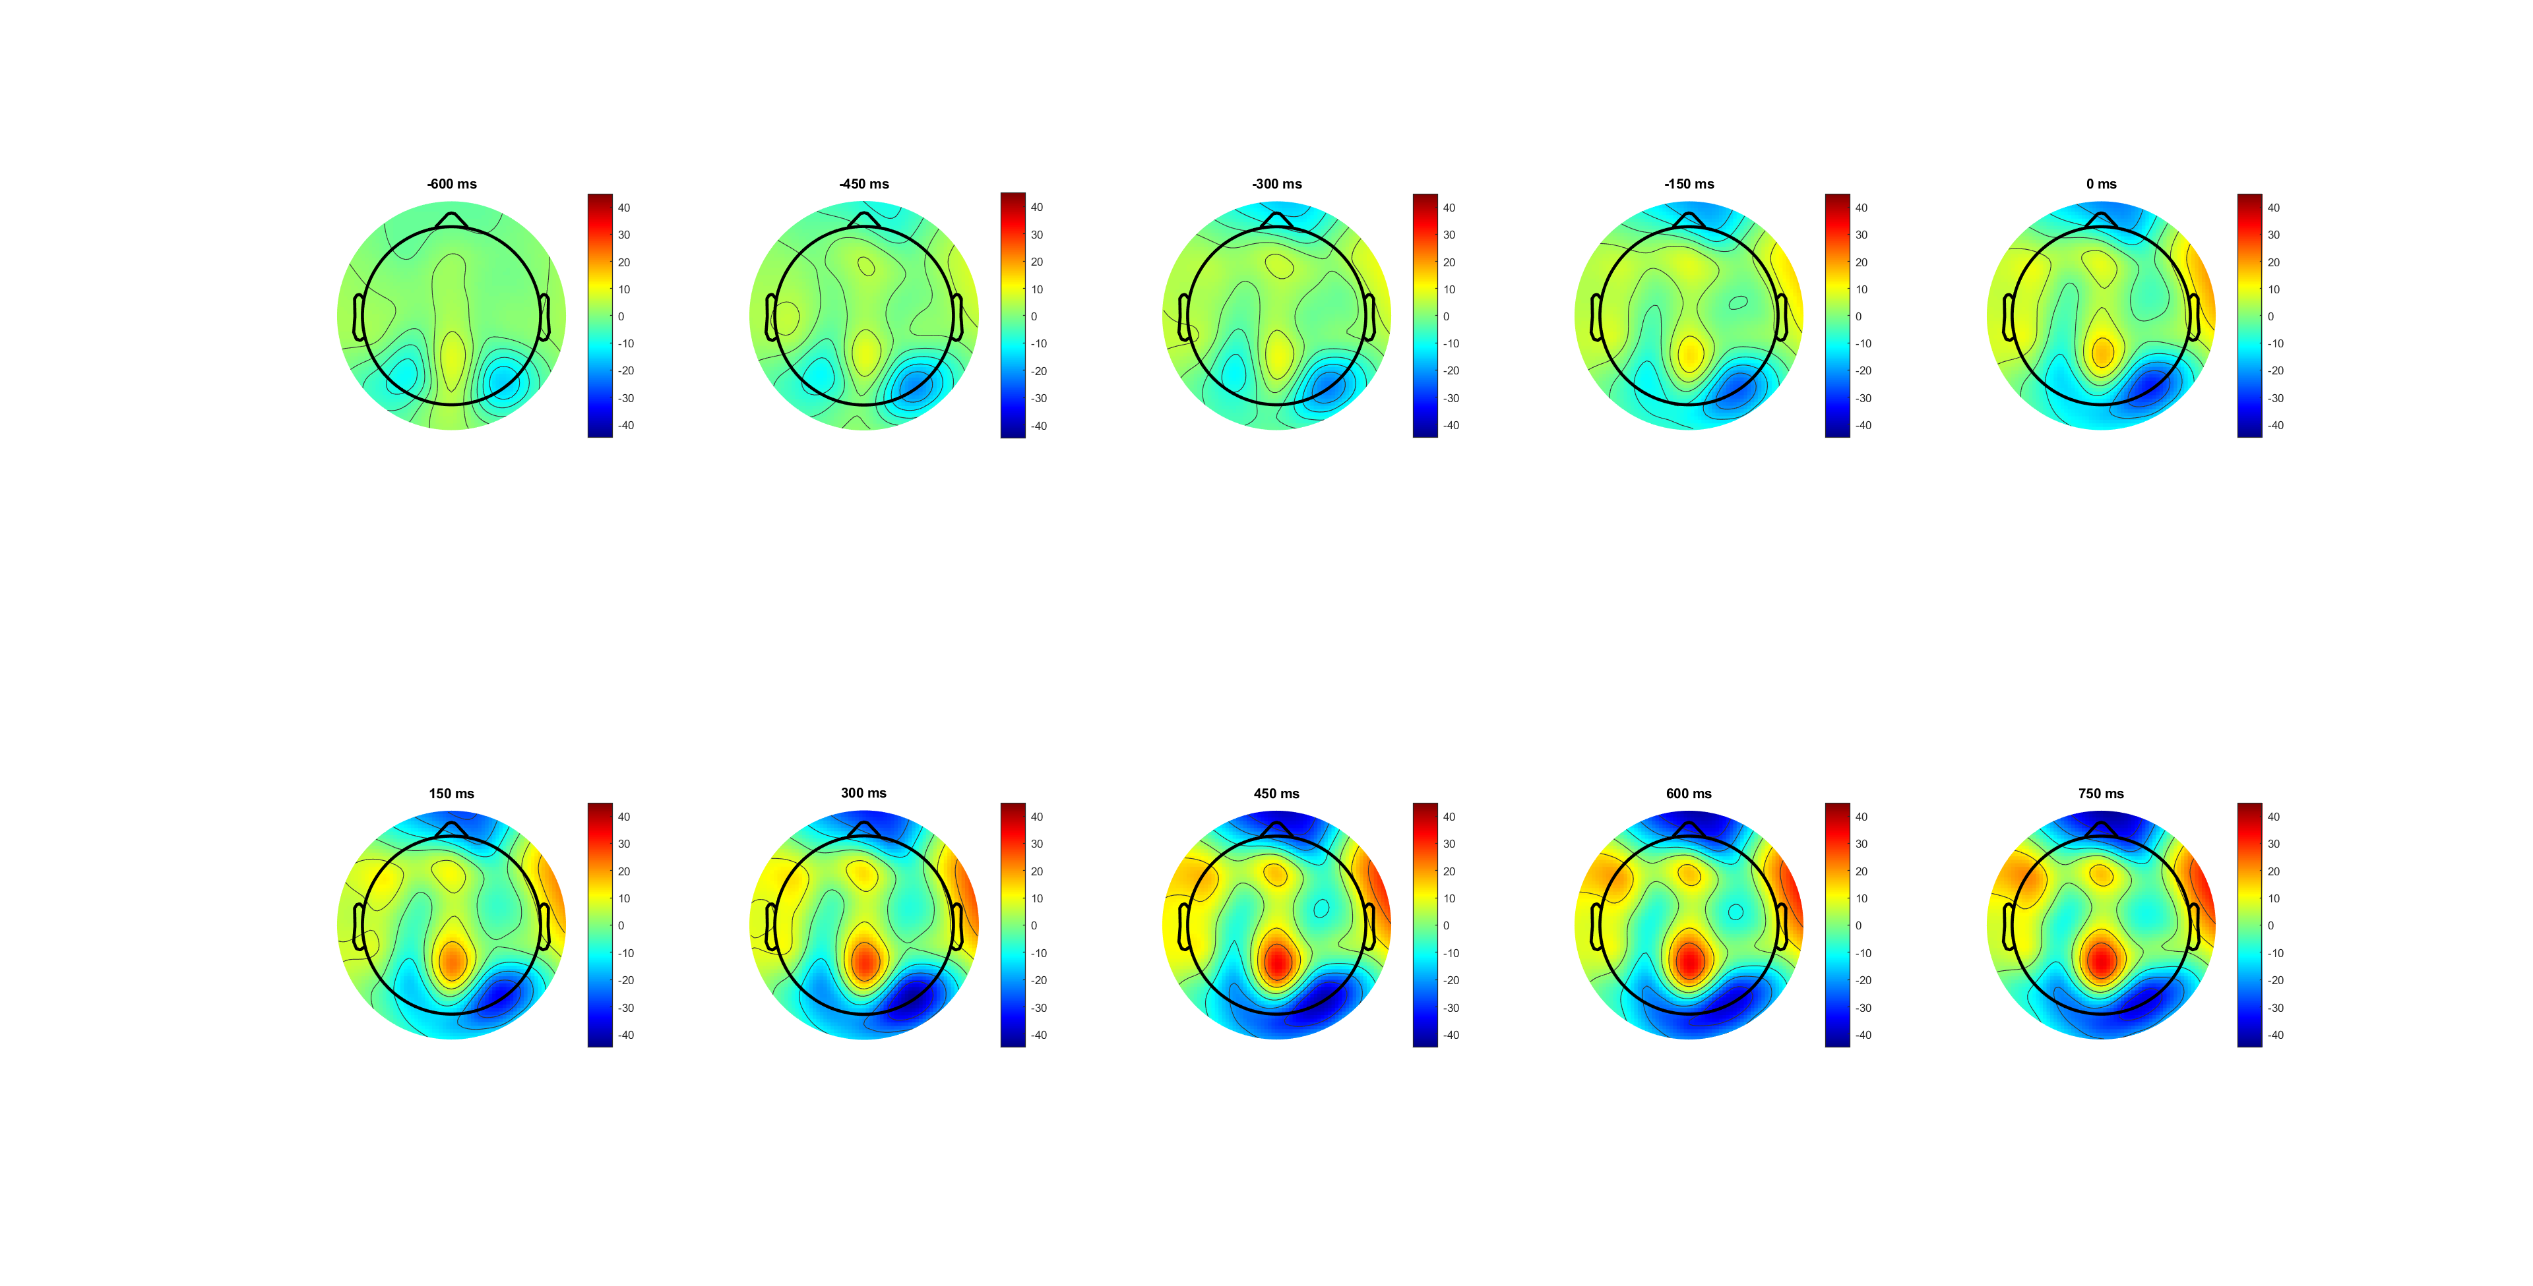
FDI (-600:750) pre cue
Slightly more CPP
Not moving

Slide 24
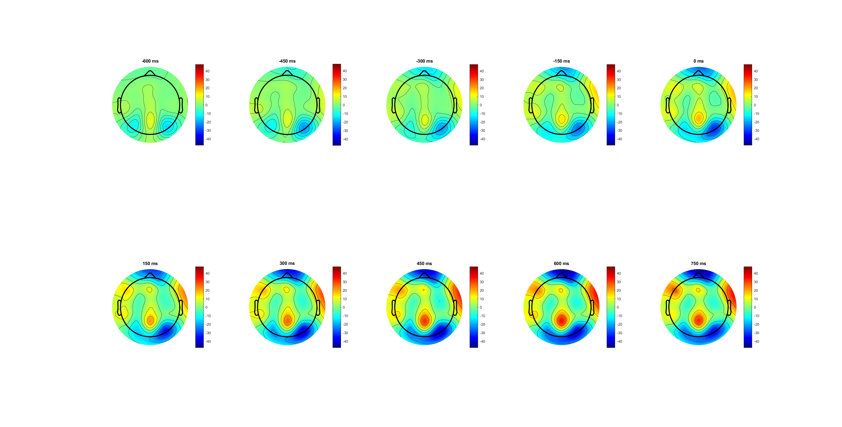
BCP (-600:750) pre cue
Slightly less CPP
Not moving

Slide 25
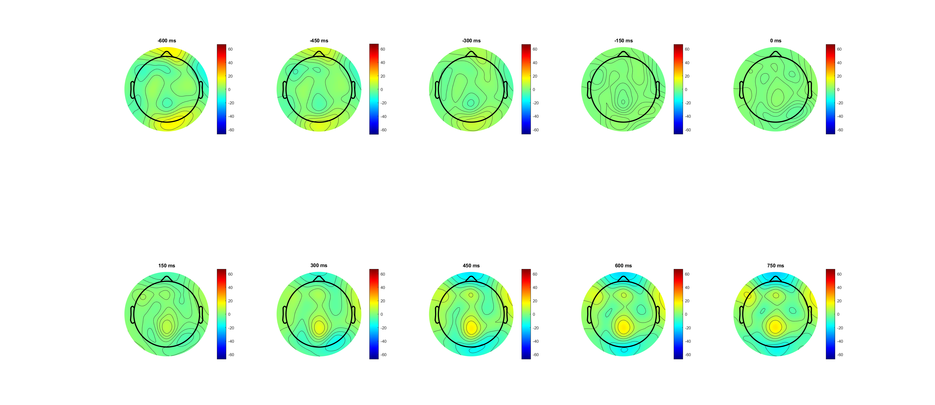
FDI (-600:750) pre evidence

Slide 26
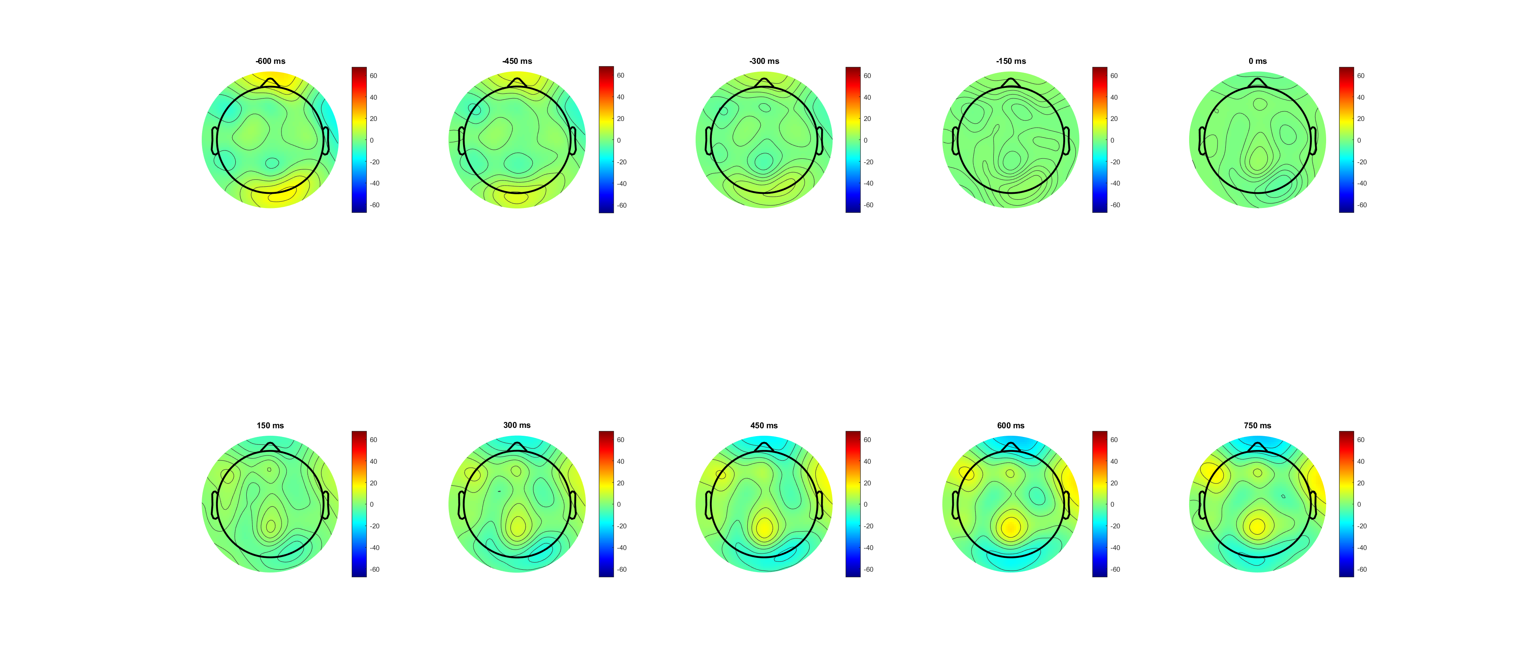
BCP (-600:750) pre evidence

Slide 27
RL_bb pre-response -188ms (FB)
Correct vs wrong
FDI vs BCP
High vs Low

Slide 28
Correct Vs Wrong (-188 before EVoff)
Correct is much higher
Peak before response and drop?? (drop 300ms before EVoff)
After Evoff wrong higher (post EMG)
post EVOFF depolarization??
Notes:
EEG_sorting_plot_SL_bb.m

Slide 29
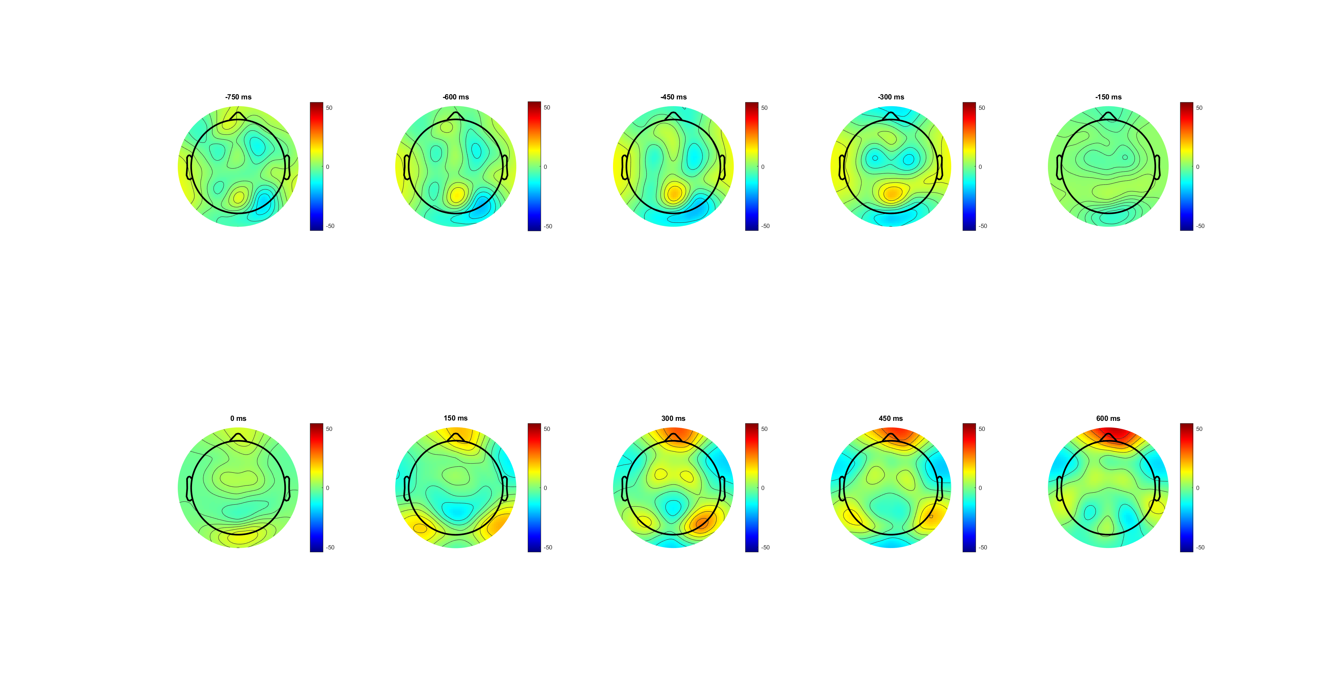
correct (-750:600) see -300(CPP) post EVOFF depolarization??

Slide 30
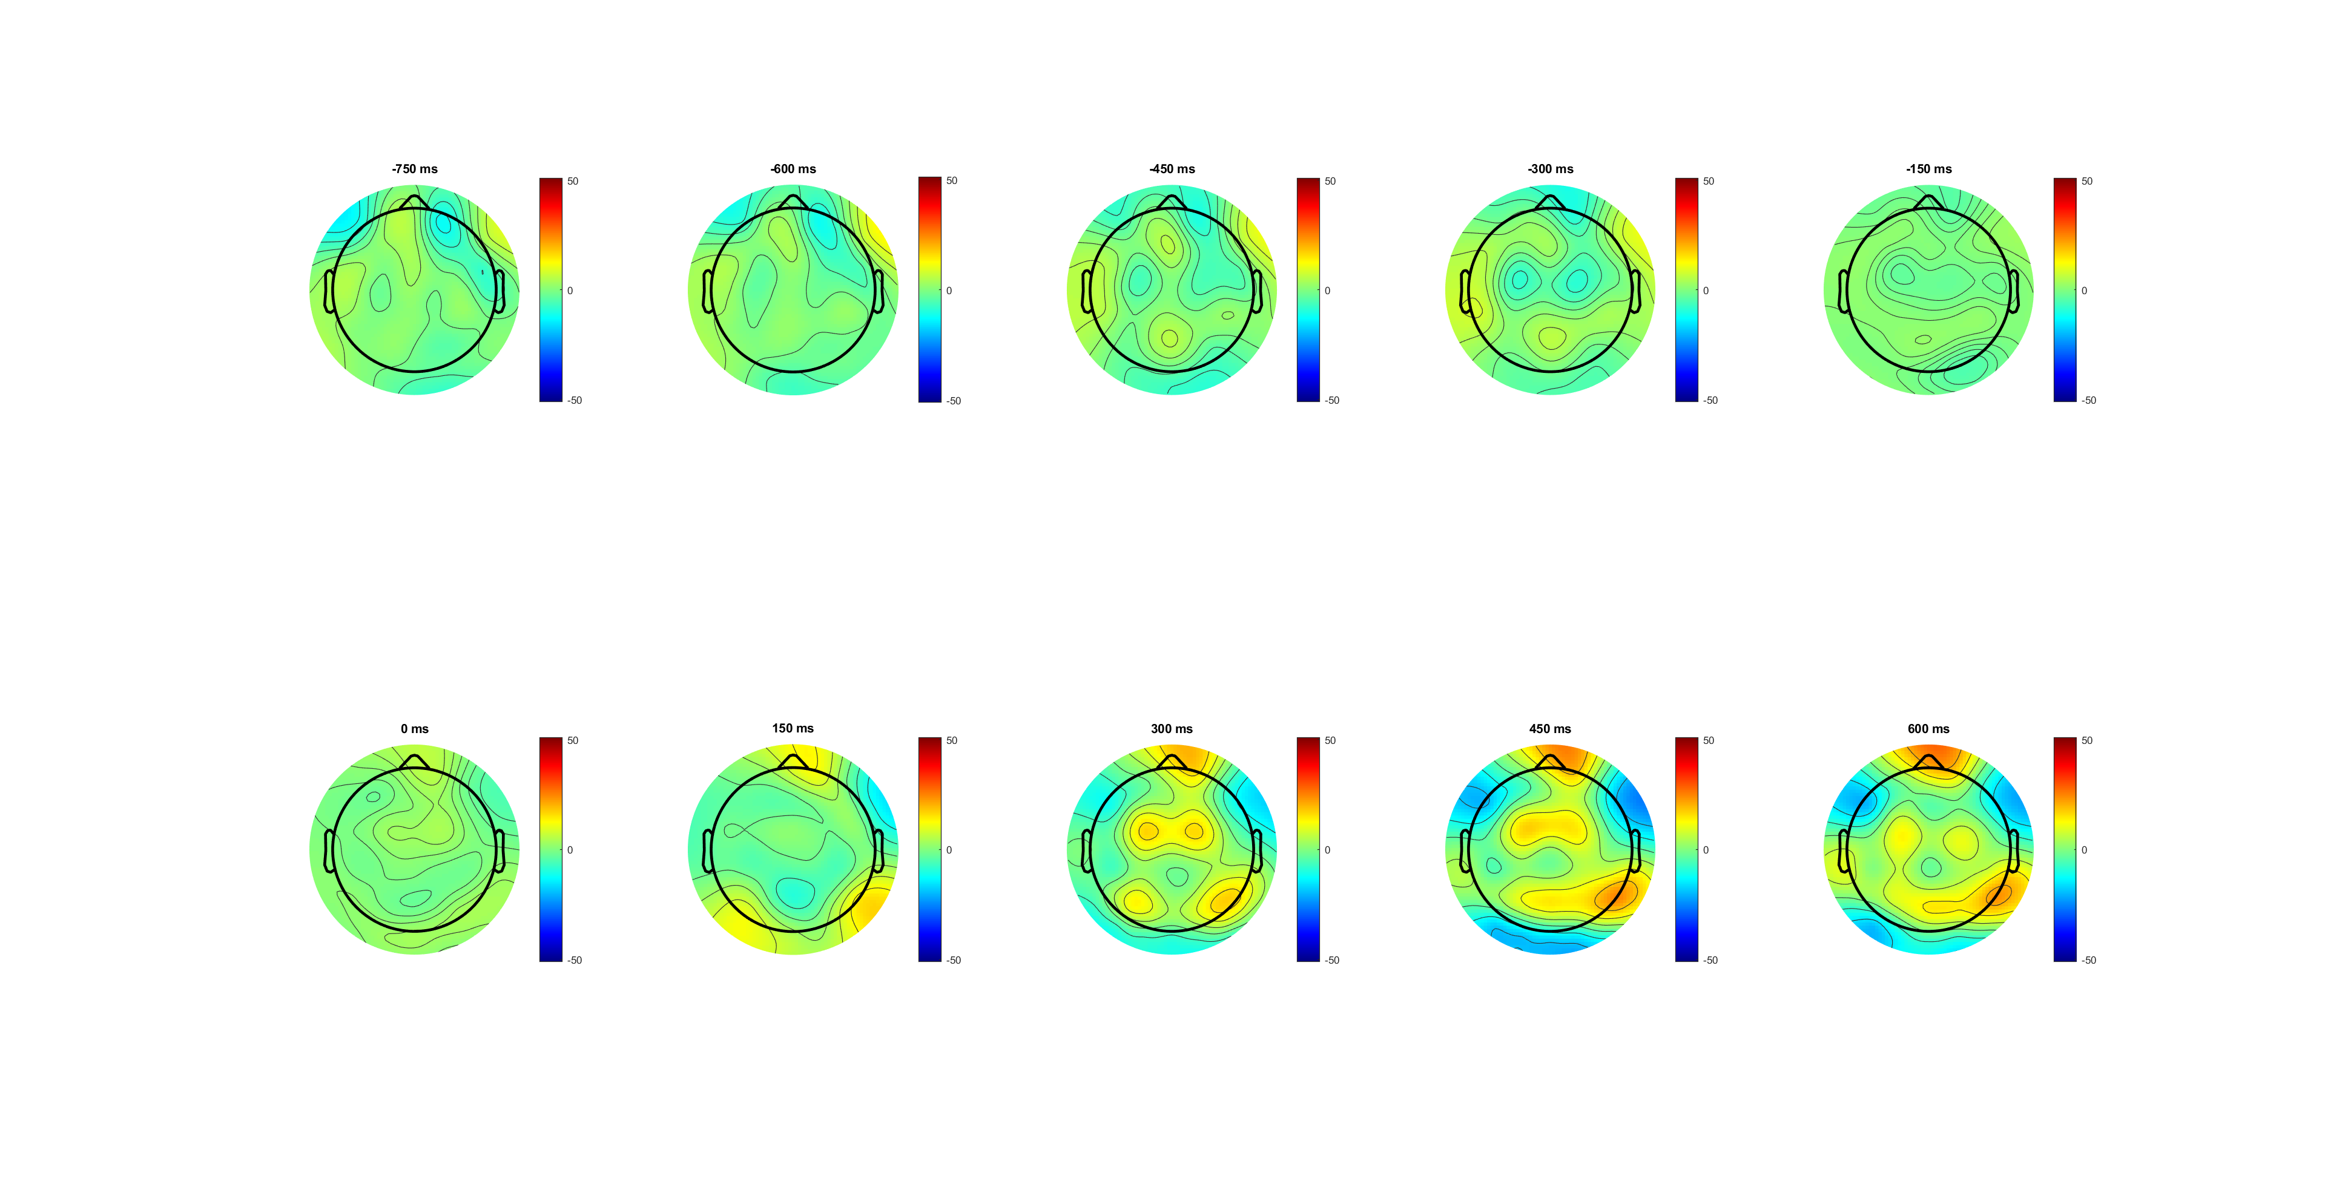
wrong (-750:600) see -300 no CPP

Slide 31
High vs low (-188 before EVoff)
‘high’ is much higher
Peak before response and drop?? (drop 300ms before EVoff)
After Evoff wrong higher (post EMG)
Notes:
EEG_sorting_plot_SL_bb.m

Slide 32
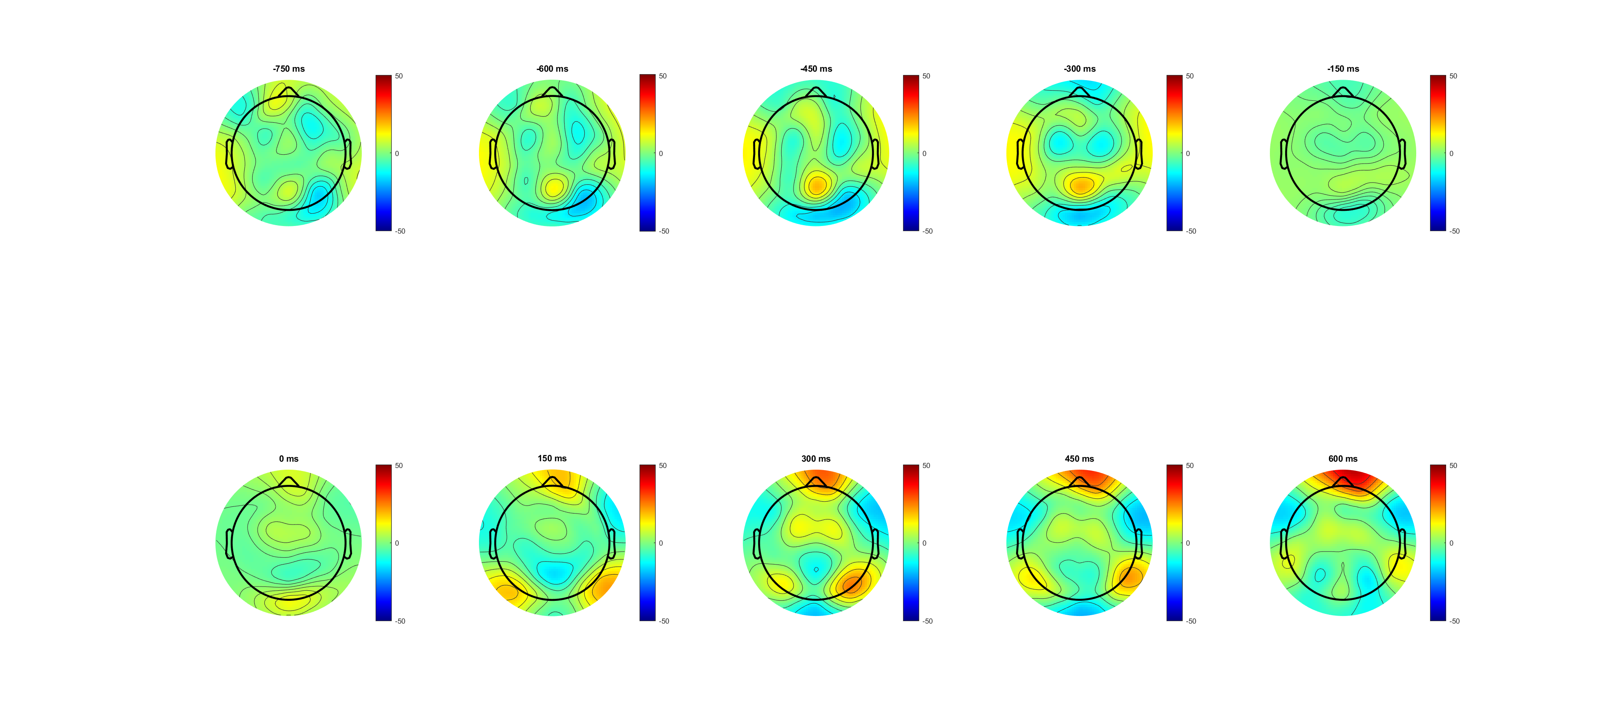
high (-750:600) see -300(CPP)

Slide 33
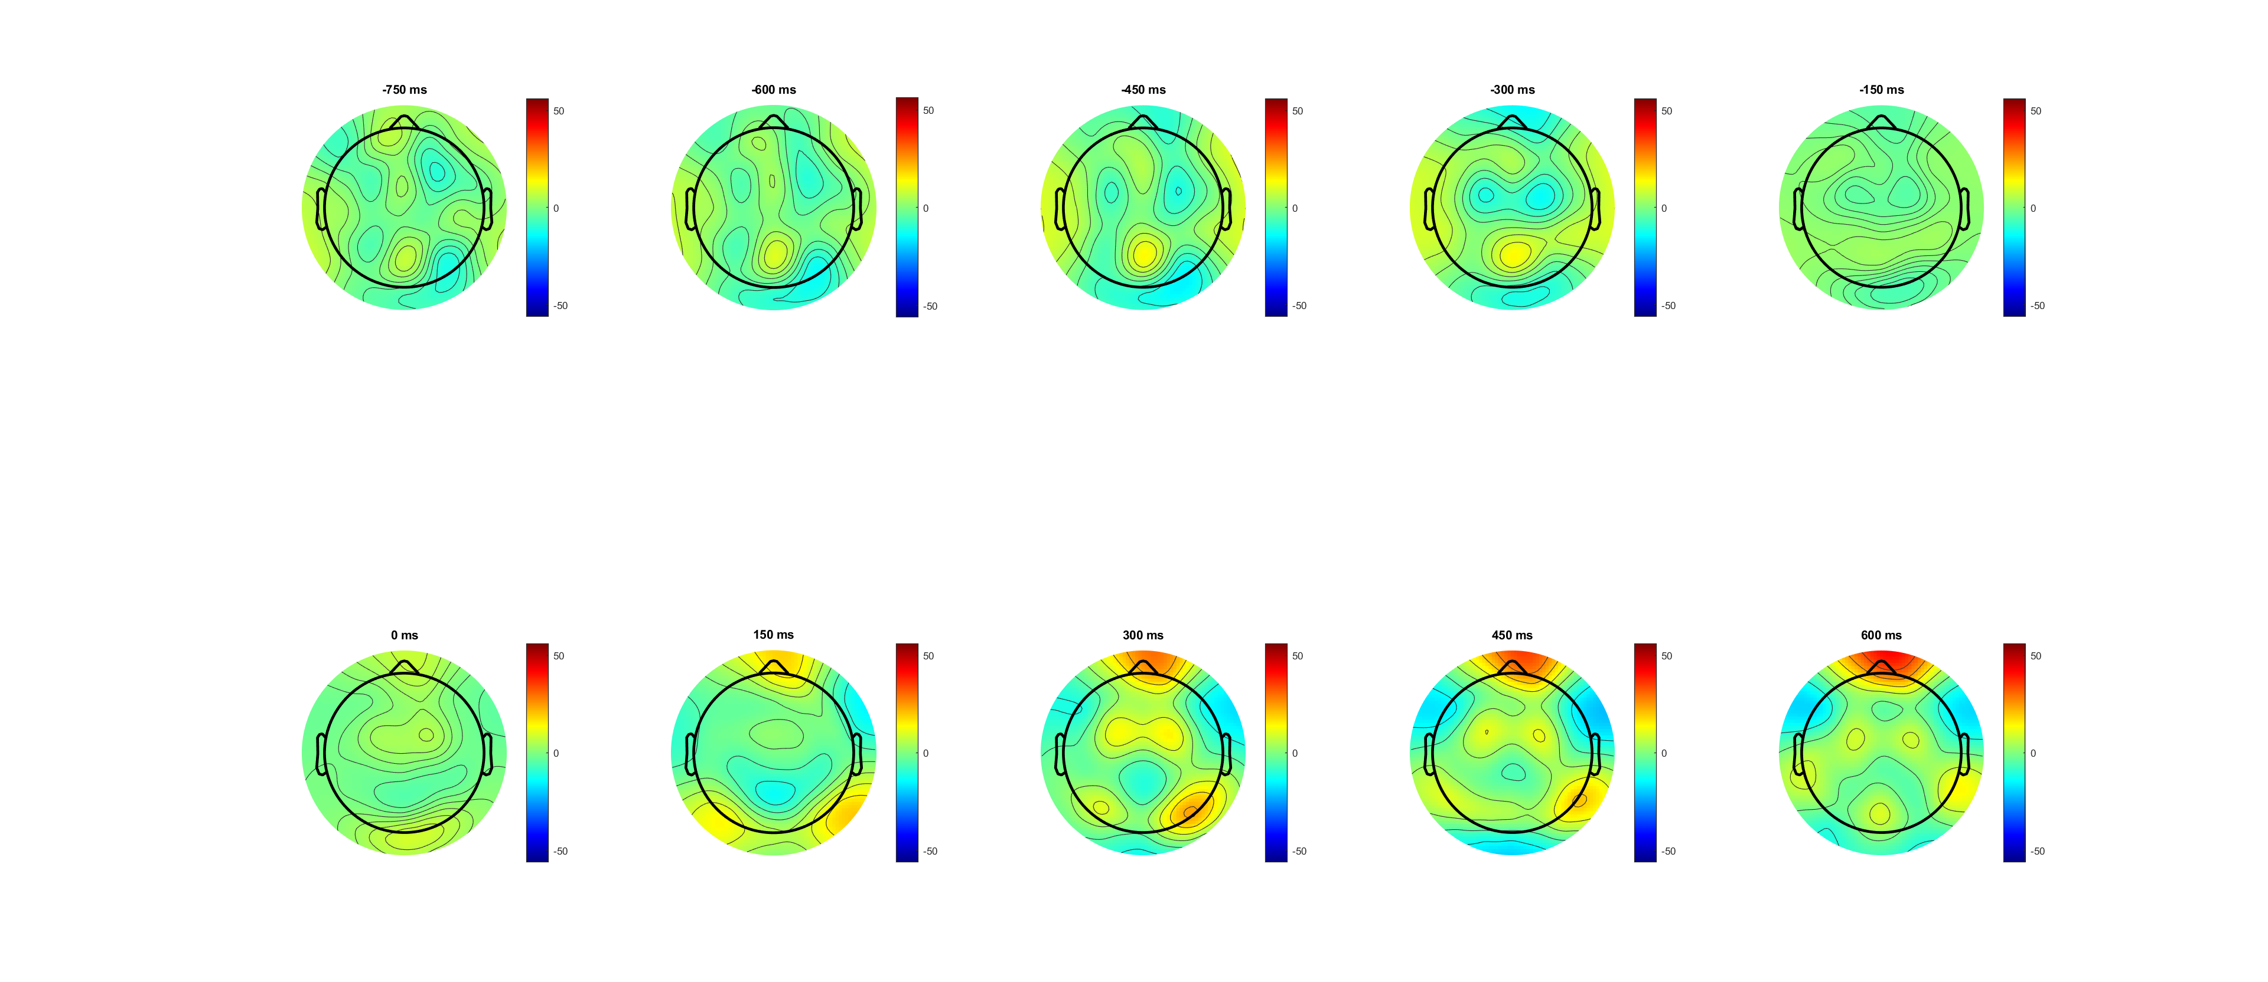
low (-750:600) see -300( smaller CPP)

Slide 34
FDI vs BCP correct (-188 before EVoff)
FDI higher before response
FDI lower after evoff
BCP higher peak!!
(scalp plot) -300 and 150 300 patten?
Notes:
EEG_sorting_plot_SL_bb.m

Slide 35
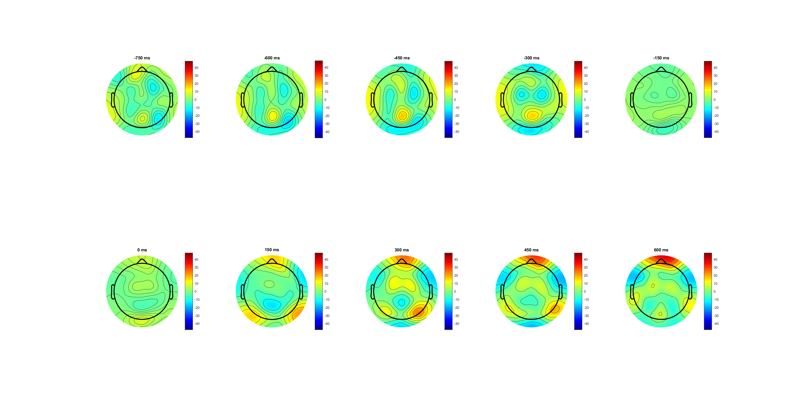
FDI (-750:600) see -300(CPP higher)

Slide 36
BCP (-750:600) see -300(CPP)

Slide 37
FDI vs BCP correct(L) wrong(R)
BCP higher peak in correct(L)
FDI higher in wrong (maybe baseline problem)
Notes:
Pre evidence

Slide 38
FDI vs BCP correct high(0.14 left) low (0.07) right
Among correct trials
BCP higher amplitude in ‘low’

Slide 39
FDI vs BCP wrong high(0.14 left) low (0.07) right
Among correct trials
BCP higher amplitude in ‘low’

